Slide 1
System Development Life Cycle (SDLC)
Reference https://www.slideshare.net/macjones25/system-development-life-cycle-sdlc-18888829

Slide 2
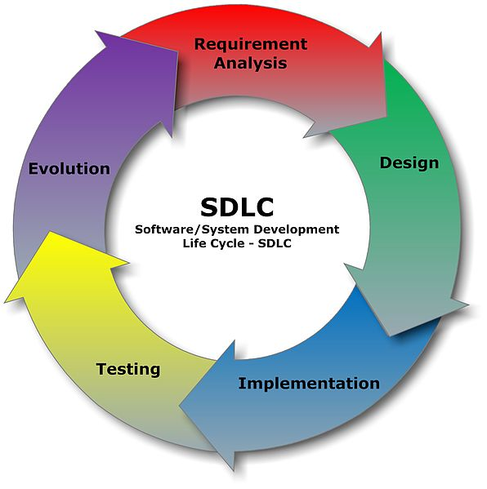
What is SDLC?
It is a conceptual model used in project management that describes the stages involved in an information system development project.

Slide 3
Recognition of Need
It can be environmental based or organizational based.
Ideas are generated to advance technology.
User originated ideas prompt initial investigation.

Slide 4
Feasibility Study
Economic: Cost benefit analysis.
Technical: We need to check whether existing computer can support the system.
Behavioral: An estimate should be made of how strong a reaction the user staff is likely to have toward the development of a computerized system.

Slide 5
Feasibility Study (Steps)
Form a project team and appoint a leader.
Prepare System flowcharts.
Enumerate potential candidate system.
Describe and identify characteristics of candidate system.
Evaluate performance.
Select best candidate system.

Slide 6
Analysis
In the Analysis stage an in-depth analysis is performed to obtain a detailed understanding of the business needs.
Tools Used: DFD’s, interviews, on-site observation, questionnaire etc.
Training, experience and common sense are required for collecting information to do anlaysis.

Slide 7
Design
It is the most creative and challenging phase of SDLC.
It defines the final system and refers to the technical specifications.
DFDs are used to show the flow of system.
Two phases: 1. Logical Design and Physical Design
Logical Design: Specifies user needs.
Physical Design: Tells the programmer what the candidate system must do.

Slide 8
Implementation
Less creative then designing phase.
It is of 3 types:
Implementation of a computer system to replace a manual system.
Implementation of a new computer system to replace an existing one.
Implementation of a modified application to replace existing one on same computer.
Parallel Runs: In this new system runs with old system which provides assurance, and even helps user staff gain experience.

Slide 9
Post Implementation
The Post-Implementation Review is used to evaluate the effectiveness of the system.
The objectives are to determine if the system does what it is designed to do
Does it support the user as required in an effective and efficient manner
The review should assess how successful the system is in terms of functionality, performance, and cost versus benefits.

Slide 10
Maintenance
The emphasis during this phase is to ensure that needs continue to be met and that the system continues to perform according to specifications.
Routine hardware and software maintenance and upgrades are performed to ensure effective system operations.
User training continues during this phase, as needed, to acquaint new users to the system or to introduce new features to current users.

Slide 11
SDLC with Prototyping

Slide 12
Why do we use prototyping approach?
It is used because of failures that occurred in the final version of the software application developed using the other SDLC approach.
There were various limitations with the other approach of SDLC and to overcome these limitations, the concept of prototyping was introduced.

Slide 13
Diagram for SDLC with prototyping
Identify User Requirements
Analyze Prototype (Input Processing Output)
Implement Prototype
Final Conversion
Post Implementation
Revised through iterative process

Slide 14
What is Prototyping?
It is an advanced technology which recognizes problem and uses advanced computer technology.
The system is built through trial and error and refined using iterative process.
It is of two types: Throwaway or Rapid Prototype and evolutionary prototype.

Slide 15
Throwaway or Rapid Prototype
It is also called closed ended prototype.
In this we create a model that will eventually be discarded instead of becoming part of final system.
After preliminary analysis, a simple working model of the system is constructed so that the user has an idea what the final system may look like.
Speed is crucial in rapid prototype.
Since with a limited budget and time, little can be expected from a system that will eventually be discarded.

Slide 16
Evolutionary Prototyping
It is different from Rapid prototyping as its main goal is to build a robust prototype in every manner and constantly refine it.
This technique allows the development team to add features that couldn’t be added in requirement and design phase.
In this, developers will focus and develop only those parts of the system which they understand perfectly.

Slide 17
Evolutionary Prototyping
The developer will not implement a poorly understood feature to help minimize risk.
Once the partial system is done, it is sent to customer sites so that they can detect opportunities for new featured.
These new features are then implemented by the developers.
Software design is updated and code is retested.

Slide 18
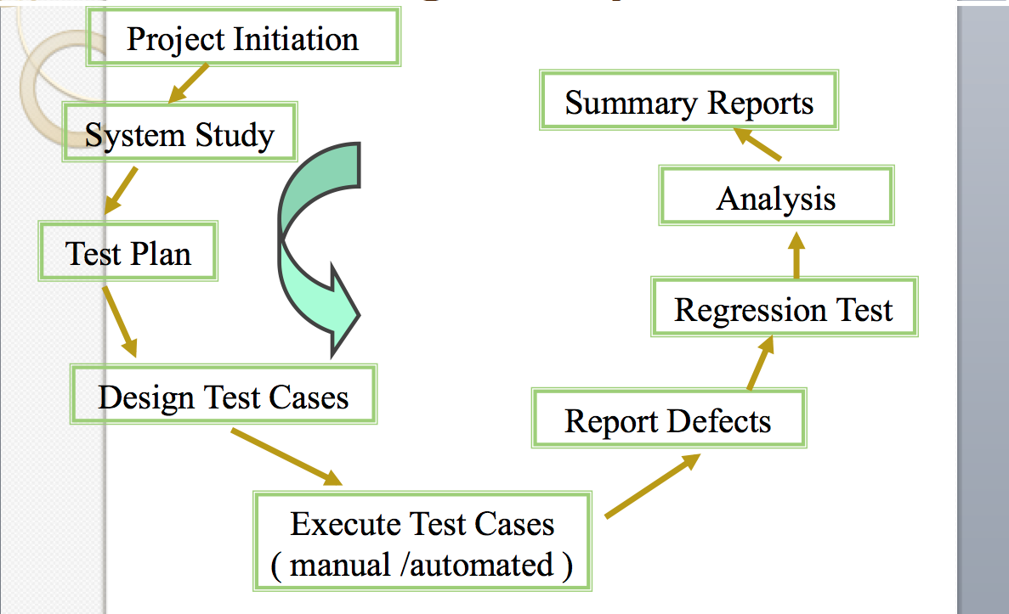
Testing Life Cycle

Slide 19
Thank You

